Slide 1

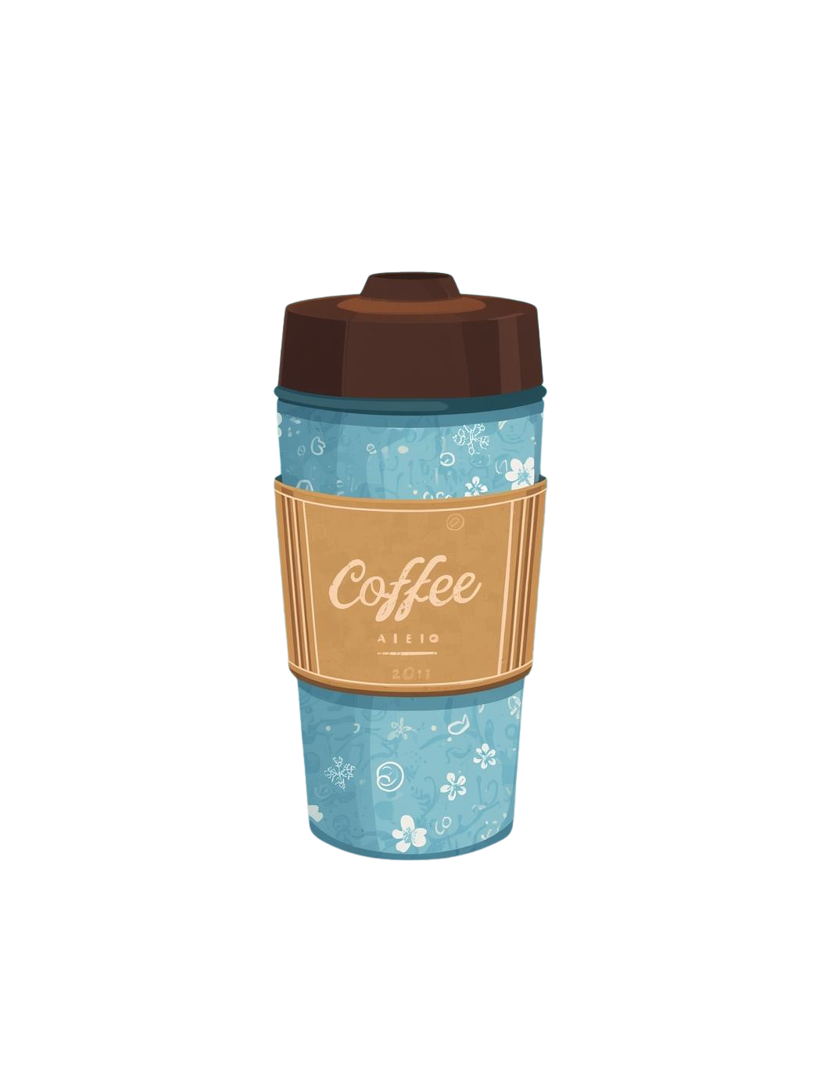






JUNIOR HIGH SCHOOL OF MYRINA
GUARDIANS OF THE AEGEAN
BRING YOUR OWN CUP
DON’T BUY COFFEE IN A SINGLE-USE CUP
JOIN THE CHALLENGE!
Take a selfie with your cup.
Upload it on Instagram.
Tag us @guardians_of_the_aegean
#MyCupForTheAegean
#BringYourOwnCup
#Probleu
LESS PLASTIC - CLEANER SEAS

