Slide 1

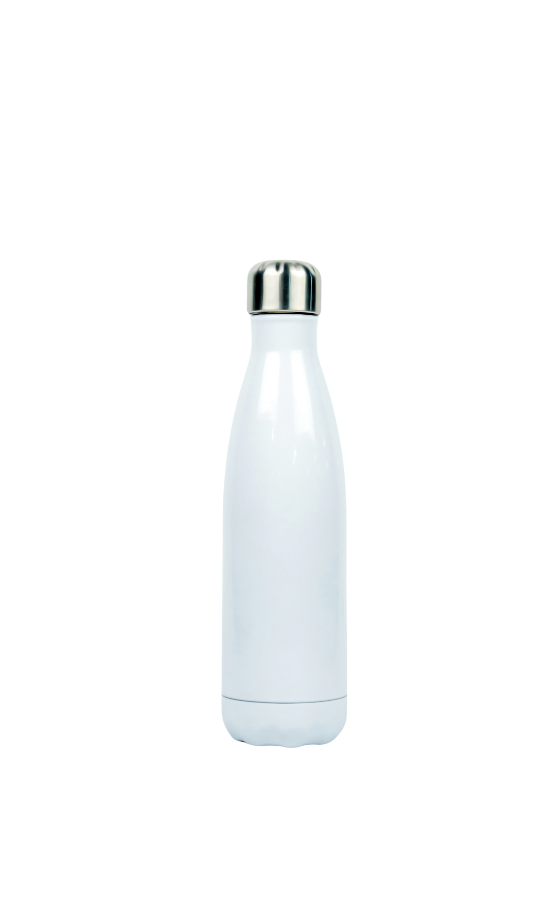




JUNIOR HIGH SCHOOL OF MYRINA
GUARDIANS OF THE AEGEAN
BRING YOUR OWN BOTTLE
DON’T BY WATER IN PLASTIC BOTTLES
LESS PLASTIC - CLEANER SEAS

